Slide 1
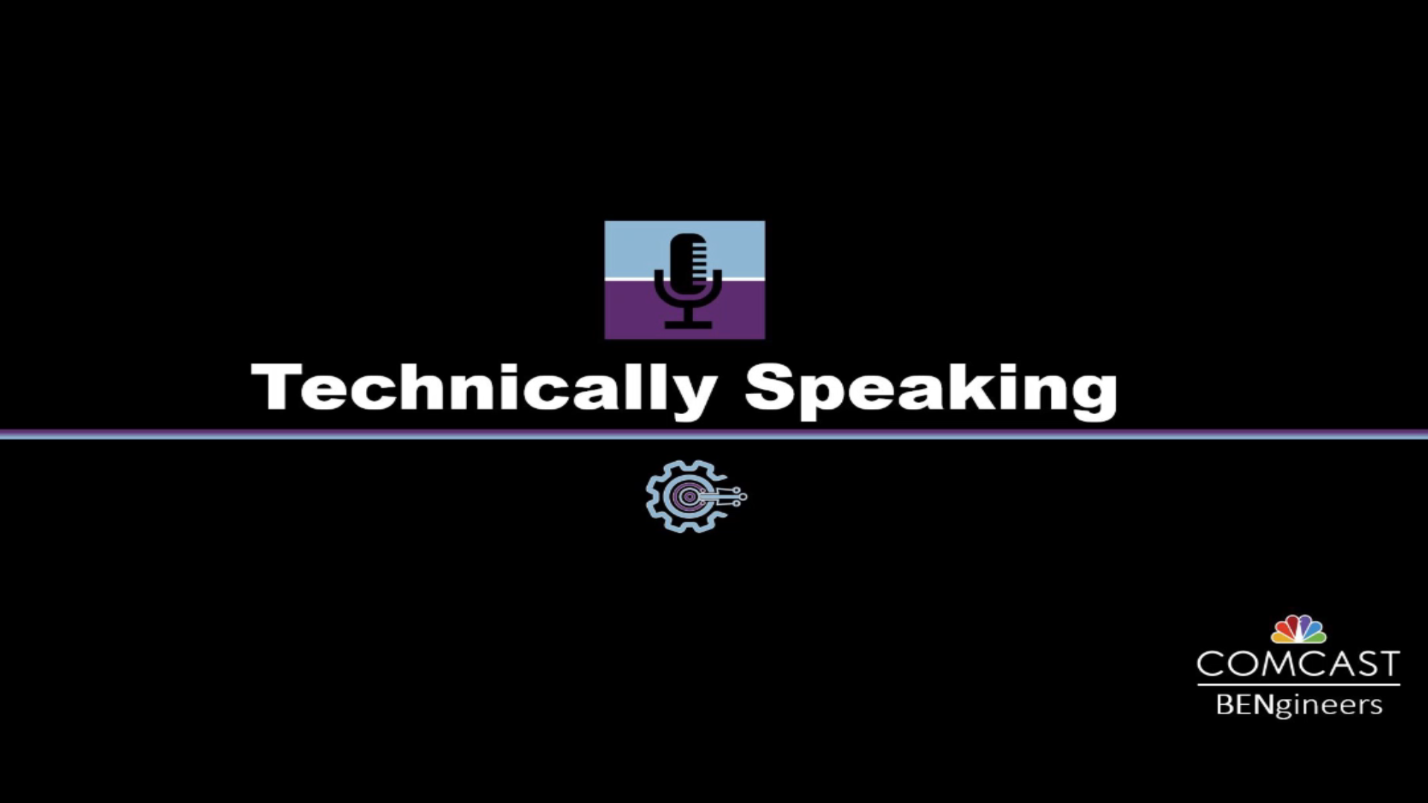

Slide 2
[Technically speaking] speaking at tech conferences
[date]
presented by: [name]

Slide 3
A tip from Aristotle
Step 1
Step 2
Step 3
Tell them what you are going to tell them
Tell them
Tell them what you told them

Slide 4
Tell them what you are going to tell them

Slide 5
Table of content
In today’s workshop, we will cover
The Essentials: Speaker Bio, Headshot, Title, Abstract
Effective Use of Your Title Slide / Importance of Branding
Tips for Speaking Virtually
The BFQs
Breaking Down the MONOLITH (slides, not microservices)
Making the Eyechart 20/20
Explaining Code in a Presentation
Getting Approval From Your Company
Call for Presentations
What we’re doing

Slide 6
Tell them

Slide 7
THE ESSENTIALS: SPEAKER BIO, HEADSHOT, TITLE, ABSTRACT

Slide 8

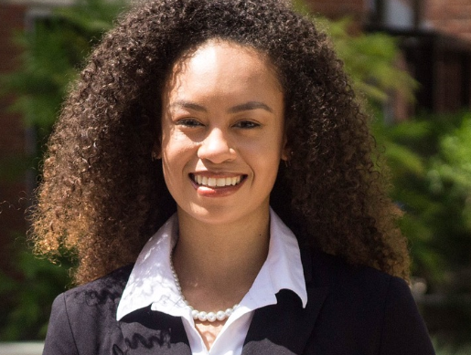
The essentials
Title:
The Dennis Botman Story
Abstract:
What do you do when you have an amazing team and you want to make them even better? The 1995 Chicago Bulls added Dennis Rodman. Well, our team at Comcast created Dennis Bot-man: An automated chatbot that helped us re-imagine how we support our internal engineering teams.
To understand why we needed this advanced level of automation, it helps to know the scale of the application we support.
Comcast's open source DNS management tool, VinylDNS, allows MILLIONS of DNS entries to be controlled by hundreds of individual groups throughout the company. This decentralized governance model is a marvel on its own. To ensure the reliability of this critical application, our group adopted a Devops model where our software engineers rotated to support the product.
Before long, our support channel was filled with questions from our users; many of which were already answered in our support documentation. Valuable time that our engineers could have been spending developing new software and features was instead spent repeatedly answering the same basic questions. Something had to be done.
In this talk, we'll tell the story of how we coded and delivered Dennis Botman to be a true member of the support team. We'll explain how Dennis Botman was able to answer over 35% of the questions being asked in our support channel. We will show how adding powerful tooling within the bot allowed engineers all over the company to solve DNS issues instantly. And perhaps most fascinating, we will use metrics to demonstrate how our support bot empowered our users by arming them with a self-service mindset.
Speaker Bio:
[Practice] Avery Smith learned how to be an engineer by sitting with her father as he experimented with a brand new language called Objective-C. By the time she went to school to study Computer Science, she had already published her first app to the ACME store. Since then, Avery has held key roles three Fortune 50 Companies. Today, she works for the same ACME company where she published her app so many years ago.
https://pixabay.com/photos/curly-hair-headshot-portrait-young-2740602

Slide 9
Creating a speaker bio
Things to include
How did you get started in engineering?
What have you done since getting started?
What is your current job?
What do you do when you are not engineering?
Do you have an advanced degree?
Were you a part of a well known project?
Speaker Bio:
[Practice] Avery Smith learned how to be an engineer by sitting with her father as he experimented with a brand new language called Objective-C. By the time she went to school to study Computer Science, she had already published her first app to the ACME store. Since then, Avery has held key roles three Fortune 50 Companies. Today, she works for the same ACME company where she published her app so many years ago.

Slide 10
EFFECTIVE USE OF YOUR TITLE SLIDE

Slide 11
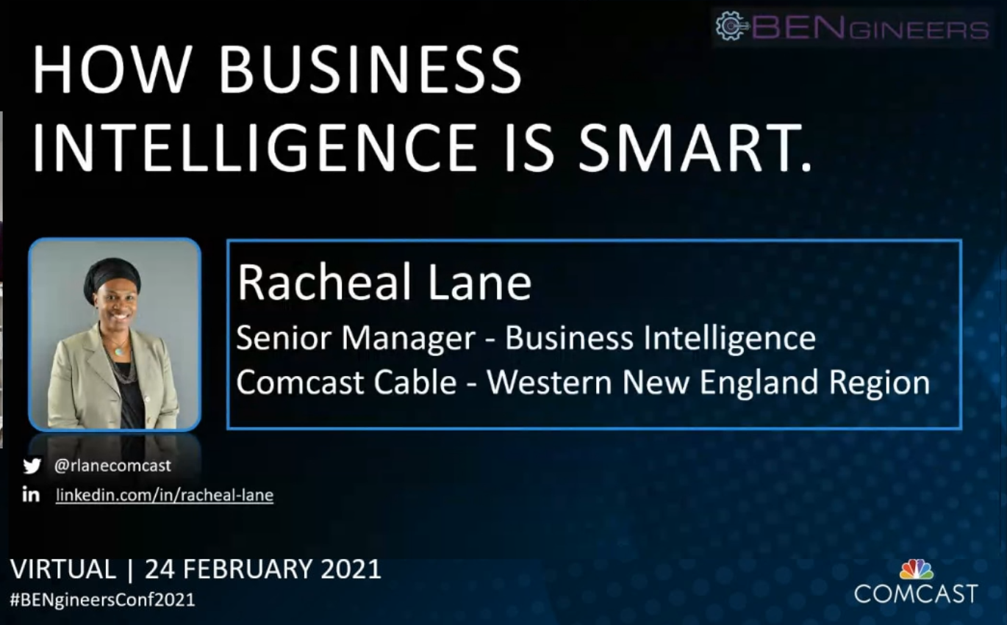
EFFECTIVE USE OF YOUR TITLE SLIDE
1
2
Screen may be displayed for a long time before you start speaking (free advertisement)
Title
Name
Job Function
Company
Photo
Contact Information
Event & Date of Presentation
6
3
4
5
7
8

Slide 12
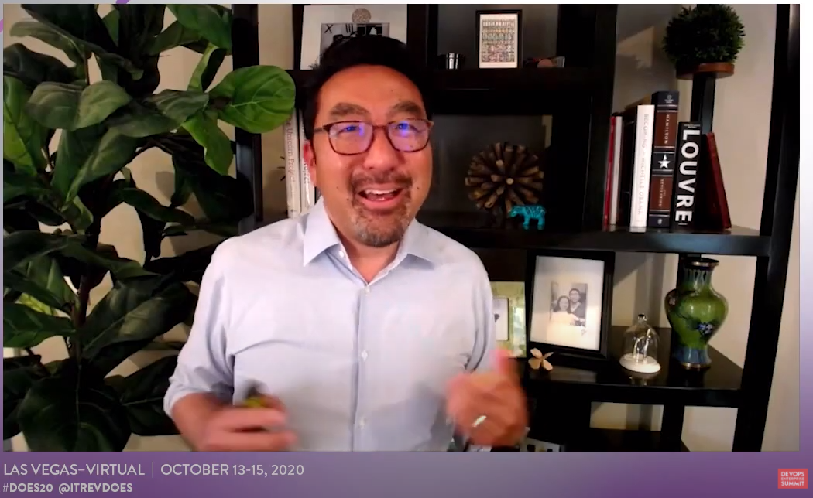

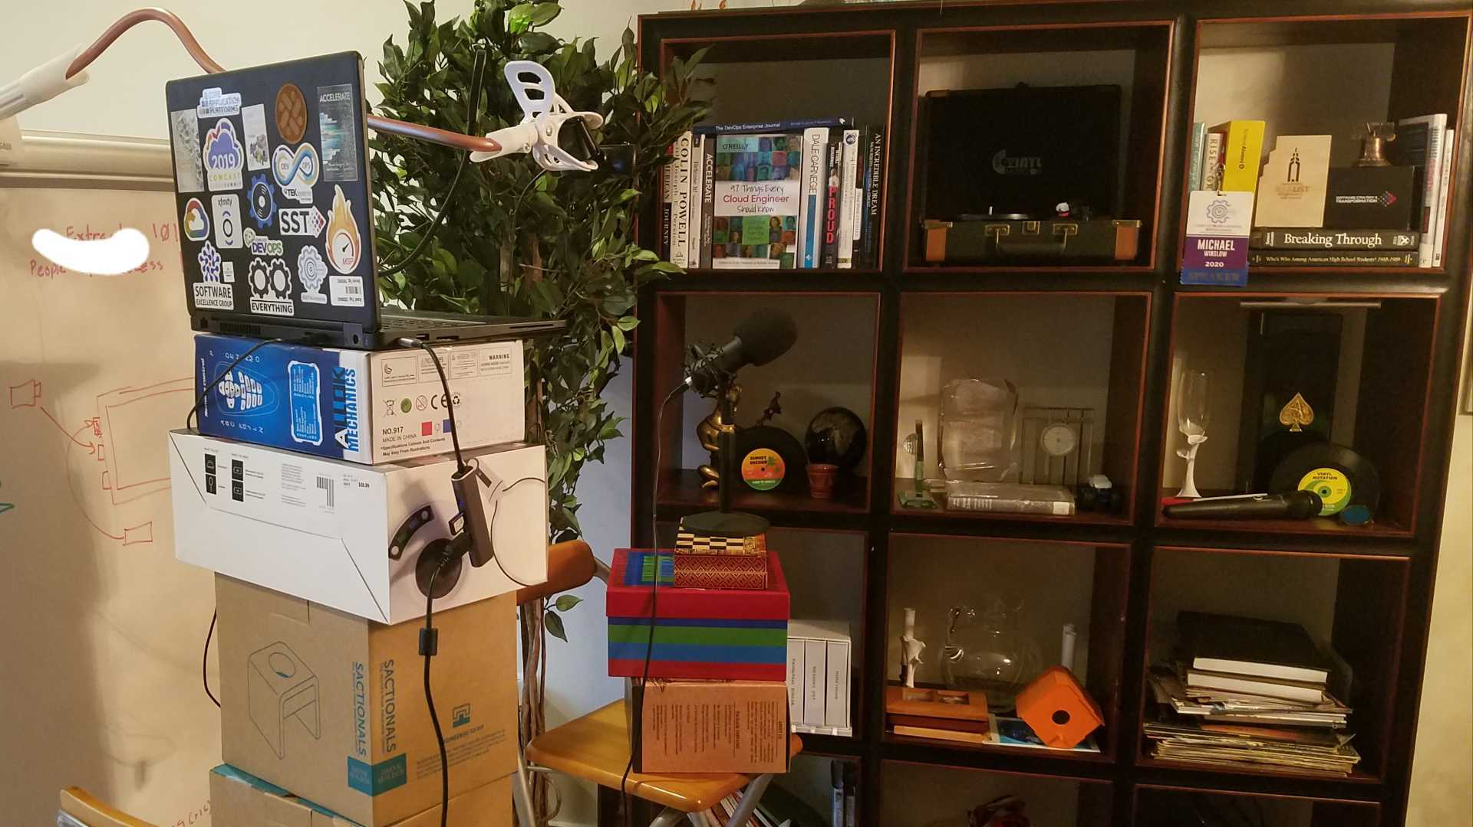

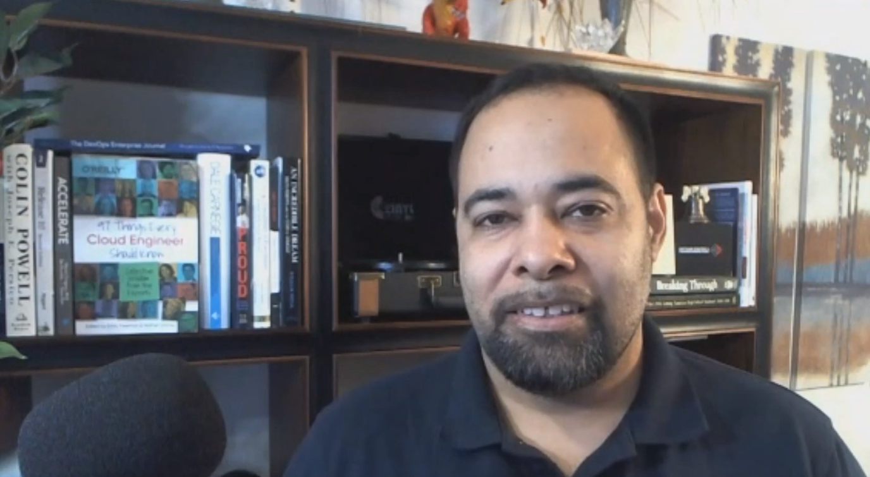
Tips for speaking virtually
Virtual Speaker Tips – by Gene Kim
Things to include
Watch that video (by Gene Kim)
Pre-Record if you can
Be aware of where your camera is .. and look at it.
Control lighting
Stand to create energy
Experiment with your setup
https://www.youtube.com/watch?v=bRXonMR8IJk

Slide 13
THE BFQs

Slide 14
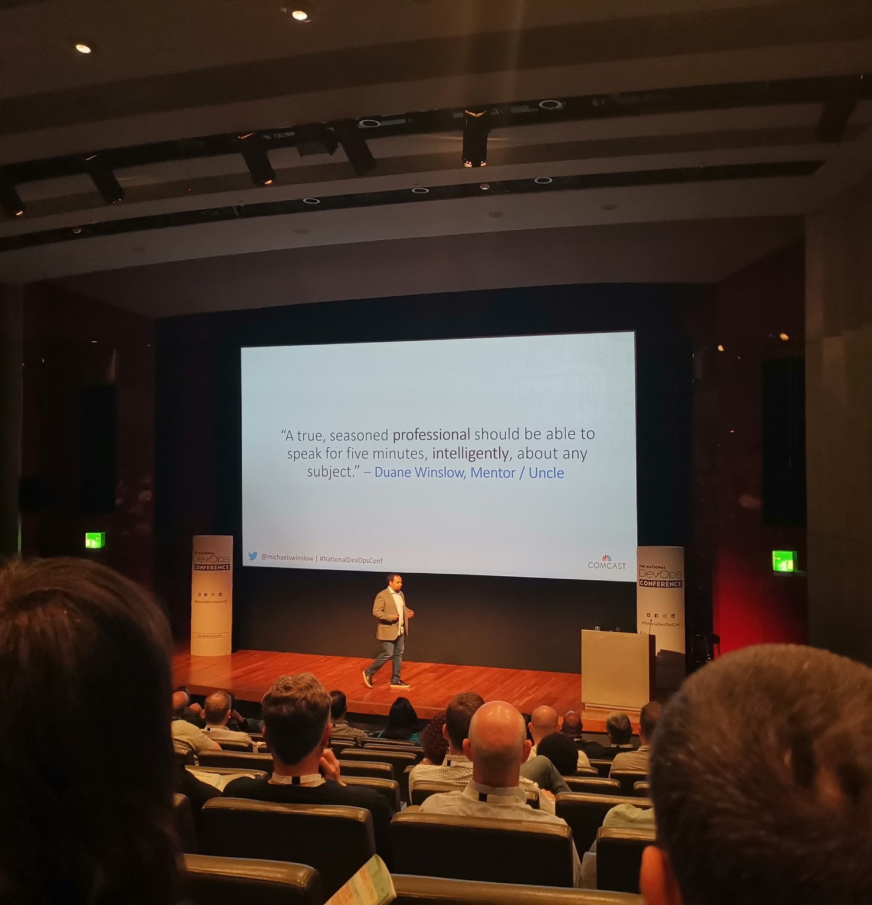
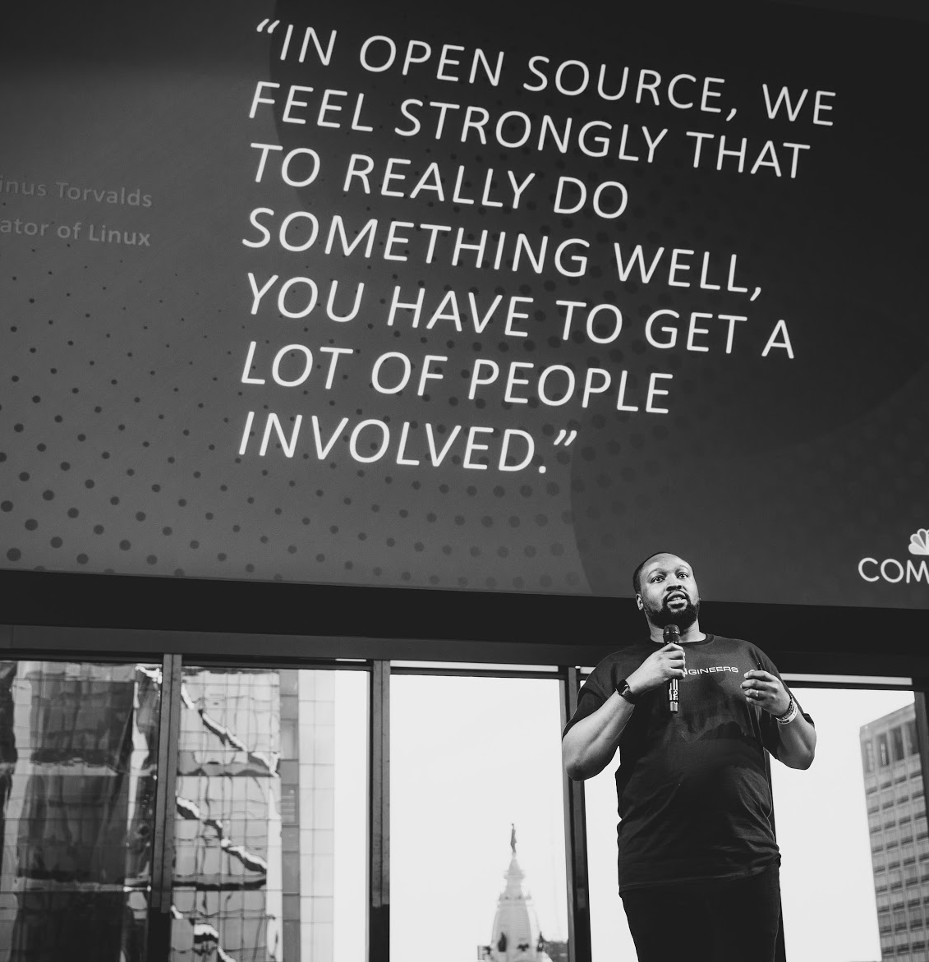

Slide 15
Why use quotations
They are great ways to introduce your ideas
Audience members want to get a picture of you in front of a quote
They make you sound smart
They are super easy to get
Google “quotes about [subject]”

Slide 16
Exercise 1: Go to google and find a bfq for the next slide

Slide 17
“[Place a fantastic quote here!]”
– Author, Title

Slide 18
Breaking down the monolith (slides)

Slide 19

ELKaaS Components
Data Shippers
Filebeat – log data shipper
Packetbeat – real-time network analyzer
Topbeat – reads system-wide and per-process CPU and memory statistics
Customer provided shippers that can send data to Kafka APIs/endpoints
Logstash – opensource data collection engine with real-time pipelining capabilities
Producers
Consumers
Elasticsearch – highly scalable open-source full-text search and analytics engine
Data node/s
Main node/s
Client node/s
Crew node/s
Kibana – opensource visualization platform
Kafka – distributed streaming platform
Zookeeper – centralized service for maintaing configuration information
Thoughts:
This is often too much to digest at once
People start reading ahead
You may lose track of where you are or even start thinking of an upcoming bullet while you are still speaking about the previous point

Slide 20
Exercise 2: Make the next slide more clear by Adding animations

Slide 21
ELKaaS Components
Data Shippers
Filebeat – log data shipper
Packetbeat – real-time network analyzer
Topbeat – reads system-wide and per-process CPU and memory statistics
Customer provided shippers that can send data to Kafka APIs/endpoints
Logstash – opensource data collection engine with real-time pipelining capabilities
Producers
Consumers
Elasticsearch – highly scalable open-source full-text search and analytics engine
Data node/s
Main node/s
Client node/s
Crew node/s
Kibana – opensource visualization platform
Kafka – distributed streaming platform
Zookeeper – centralized service for maintaining configuration information

Slide 22
Making the eyechart 20/20
Notes:
Section on keeping the audience engaged when trying to explain architecture or code

Slide 23
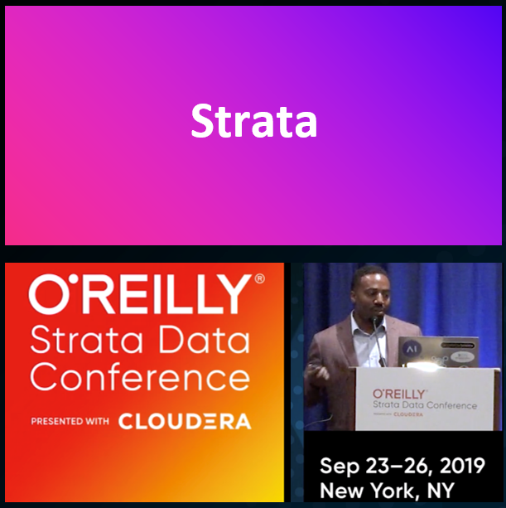
Mumin Ransom

Slide 24
Exercise 3: Make the next slide more clear by CREATING A LOGICAL FLOW

Slide 25



Machine Learning(ML) Lifecycle – Workflow
Inception
Exploration
Model Development
Candidate Model Selection
Model Operationalization
Model Evaluation
Go Live Phase
Define Use Case
Model Review
Model Selection
Evaluate Live Model Performance
Go Live with Selected Models
Business User
Iterate
Identify Model Types & Explore Features
Create & Validate Models
Monitor Live Models
Collect new data & retrain
Data Scientist
Iterate
Define Online Feature Assembly
Define pipeline to collect outcomes
Model Deployment and Monitoring
Create and publish new features
ML Operations

Slide 26
Explaining code in a presentation

Slide 27
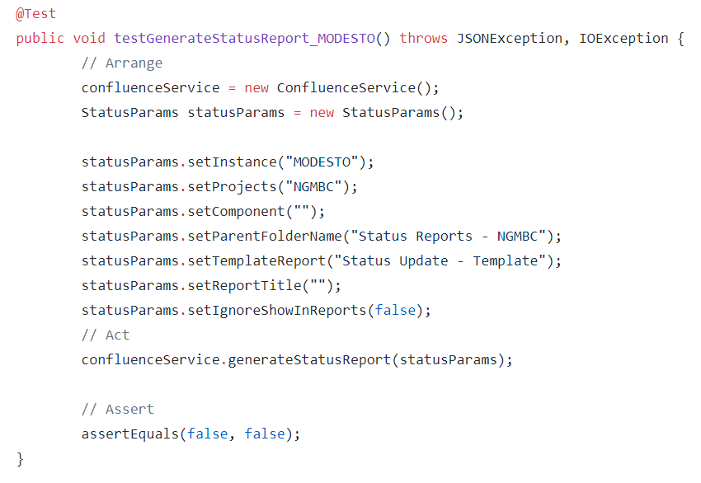
Using the triple-A pattern for unit tests
A j-unit test method is very similar to any other method in java. There is a specific annotation which helps identify this method as a test
Then, you have your standard modifier, return type, method name and exception types
Within the method itself, we use the triple-A pattern to logically separate the parts of the test
Arrange is where we setup what the state of the application needs to be before the method we are testing is called
Act is when we actually call the method
Assert is when we confirm that the method yields the expected results
Note: a rule of thumb in triple-A is that the “Act” section has only one line … the specific method being tested

Slide 28
Submitting a cfp (call for Presenters)

Slide 29
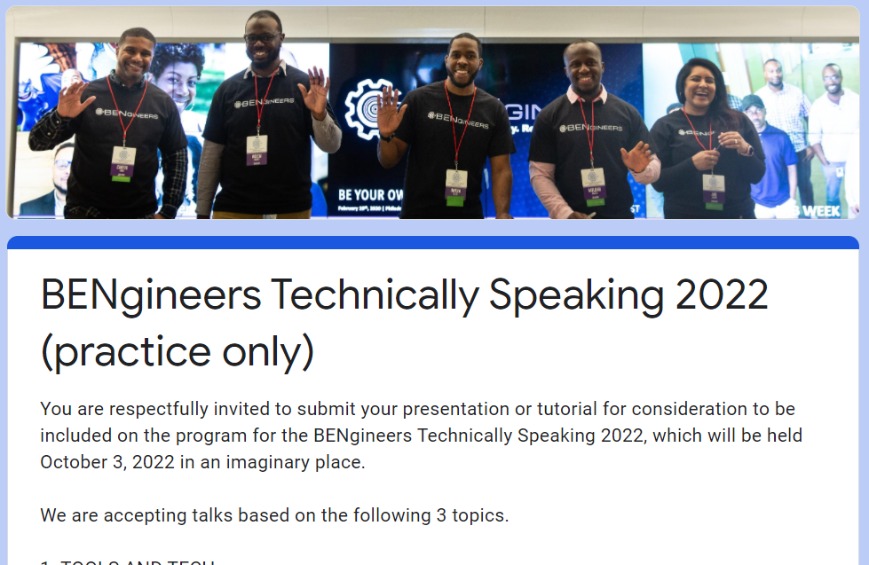
Exercise 4: Submitting a cfp
BENgineers technically speaking Sample CFP
Use the content from the previous exercise
This is not a real CFP…don’t worry
Feel free to use a fake email address
Other CFPs are similar to this one
Sample CFP ( https://forms.gle/fuetpKtnMyjgskgH7 )

Slide 30
Tell them what you told them

Slide 31
summary
What we did
In today’s lesson, we:
Learned the important requirements of a technical talk
Learned Several Slide Techniques
Submitted a mock CFP

Slide 32
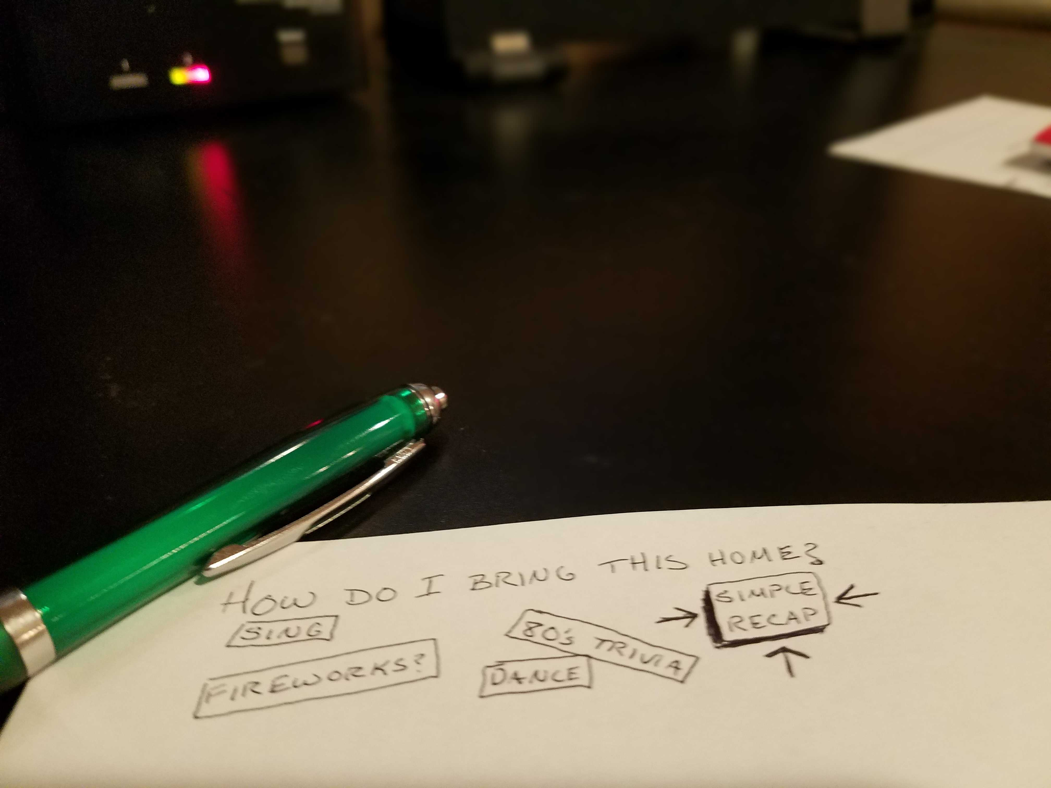

Internal / External Conferences
Sprint Demos
Planning Meetings
What Now?:

Slide 34
Q&A

Slide 35
appendix

Slide 36
ELKaaS Components
Data Shippers
Filebeat – log data shipper
Packetbeat – real-time network analyzer
Topbeat – reads system-wide and per-process CPU and memory statistics
Customer provided shippers that can send data to Kafka APIs/endpoints
Logstash – opensource data collection engine with real-time pipelining capabilities
Producers
Consumers
Elasticsearch – highly scalable open-source full-text search and analytics engine
Data node/s
Main node/s
Client node/s
Crew node/s
Kibana – opensource visualization platform
Kafka – distributed streaming platform
Zookeeper – centralized service for maintaining configuration information

Slide 37
Machine Learning(ML) Lifecycle – Workflow
Inception
Exploration
Model Development
Candidate Model Selection
Model Operationalization
Model Evaluation
Go Live Phase
Define Use Case
Model Review
Model Selection
Evaluate Live Model Performance
Go Live with Selected Models
Business User
Iterate
Identify Model Types & Explore Features
Create & Validate Models
Monitor Live Models
Collect new data & retrain
Data Scientist
Iterate
Define Online Feature Assembly
Define pipeline to collect outcomes
Model Deployment and Monitoring
Create and publish new features
ML Operations

Slide 38
ONE LINE ONLY

